Slide 1
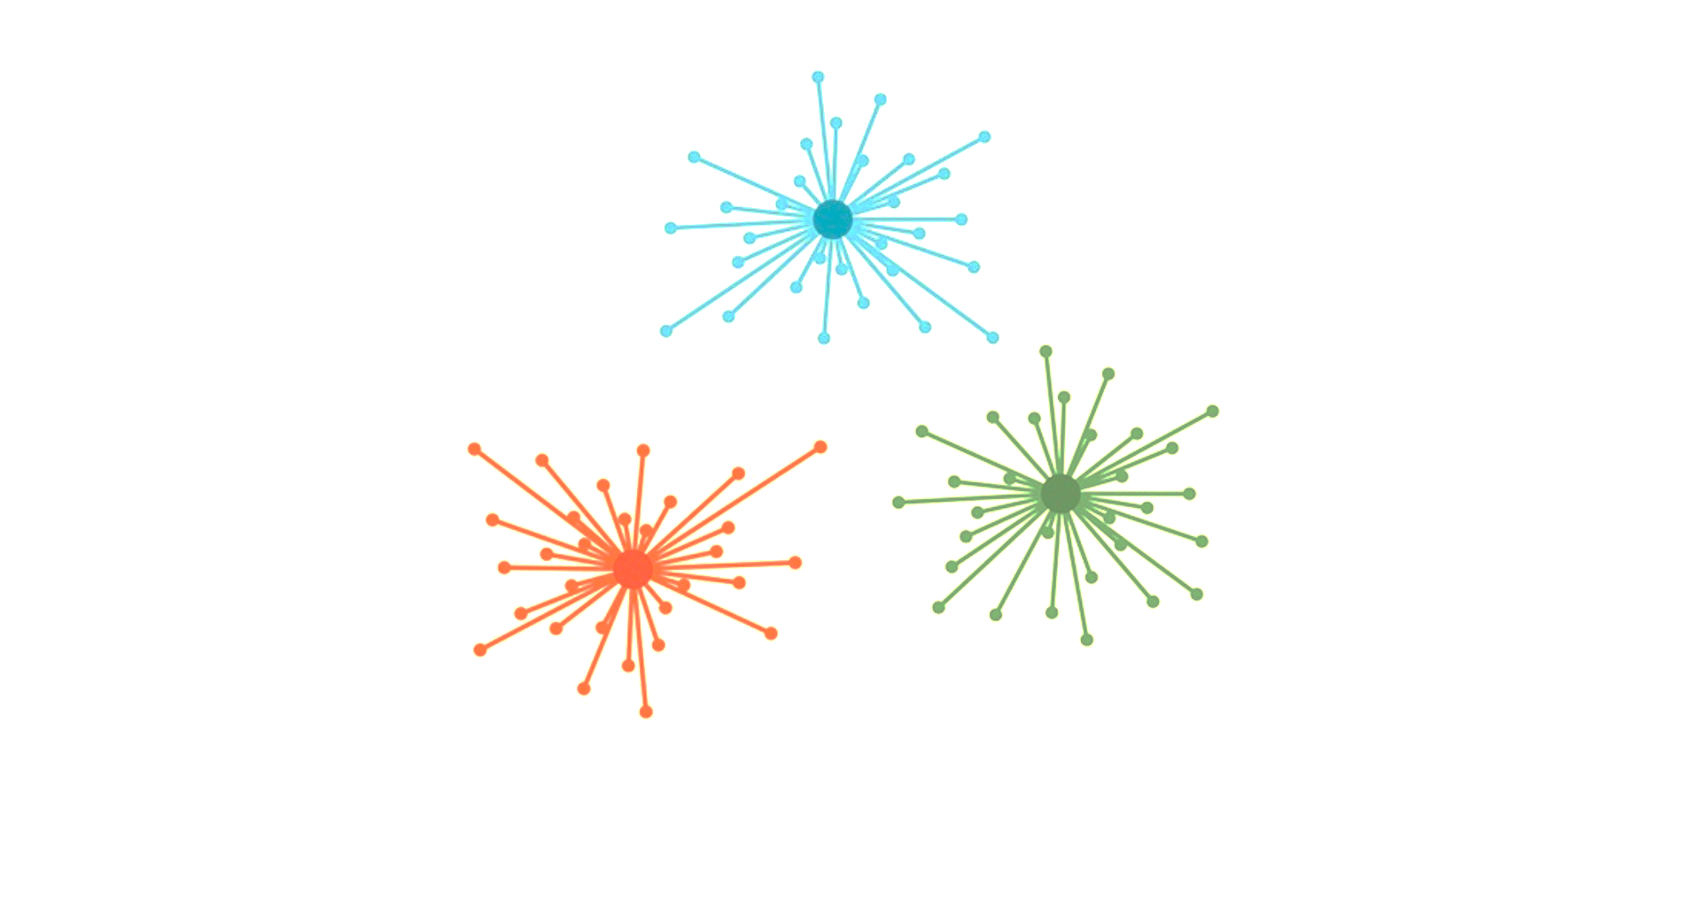
Affinity Propagation
from sklearn.cluster import AffinityPropagation
ap = AffinityPropagation(random_state=5)
ap.fit(X)

Slide 2
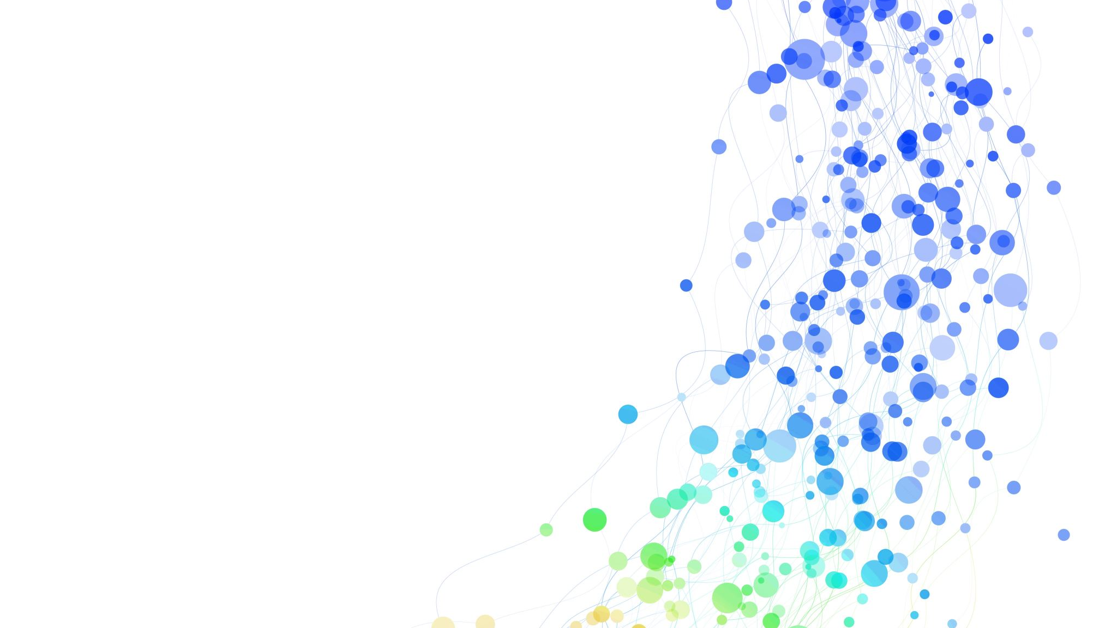
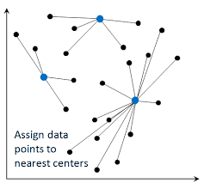
Affinity Propagation
No need to pre-specify the number of clusters Unlike K-Means, Affinity Propagation automatically decides how many clusters should exist.
Message passing between data points
Each data point exchanges messages with others.
Messages are not sent to everyone — they are sent mainly to potential exemplars (cluster leaders).
Exemplars (Cluster leaders)
An exemplar is a data point that represents a cluster.
All data points assigned to that exemplar share similar features/characteristics.
Exemplars define the clusters.
When new data arrives
The new point automatically joins the nearest exemplar’s cluster.

Slide 3
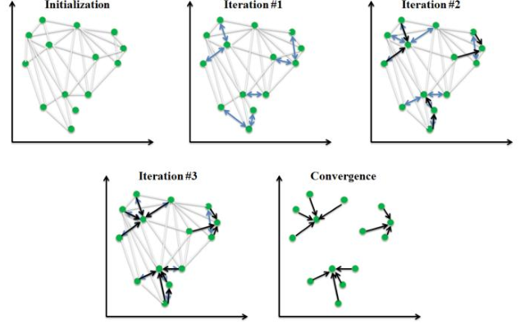
Affinity Propagation
The algorithm alternates between updating responsibility and availability messages until convergence, which is typically determined by stability in exemplar assignments or after a set number of iterations.

Slide 4
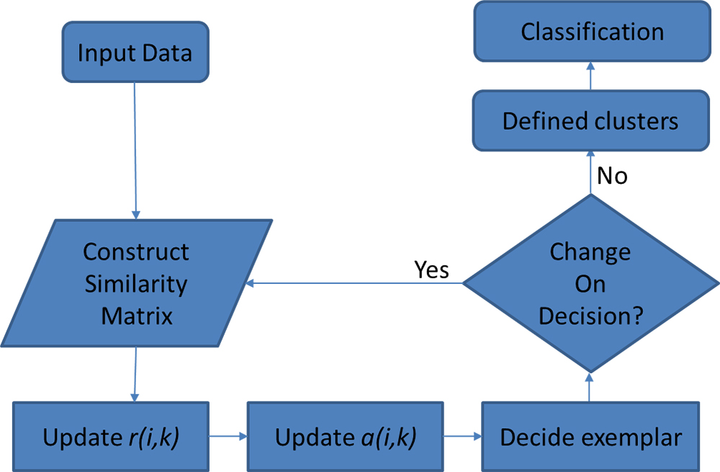
Think of a classroom where students are looking for group leaders.
Students (data points) first suggest who would be the best leader (responsibility).
Then potential leaders decide whether they can take on more members (availability).
After some rounds of communication, the strongest leaders (exemplars) remain, and students gather under them → forming clusters.

Slide 5
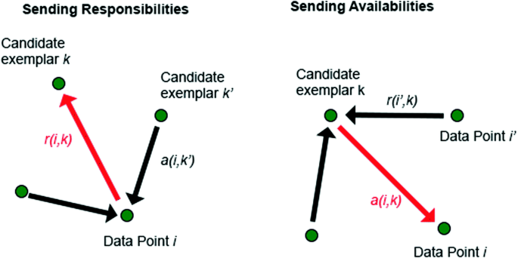
Two Types of Messages: Responsibility (r): “How suitable is this candidate exemplar for me?” A measure of how well one data point fits under another as its leader. Availability (a): “Am I really available to be your leader?” It checks whether a candidate exemplar is supported by other data points. If not, it essentially says: “I don’t match you well, try another exemplar.”

Slide 6
Affinity Propagation
Advantages
Automatic No of Clusters
Exemplar based Clustering
Handles Complex Structures
Disadvantages
Computational Cost
Memory Usage
Assumption of Globular Clusters
Uses
Target Marketing
Document Clustering
Image Clustering
Social Network Analysis
Python Code
from sklearn.cluster import AffinityPropagation
ap = AffinityPropagation(random_state= 3)
y_aff = ap.fit_predict(X)

